Slide 2
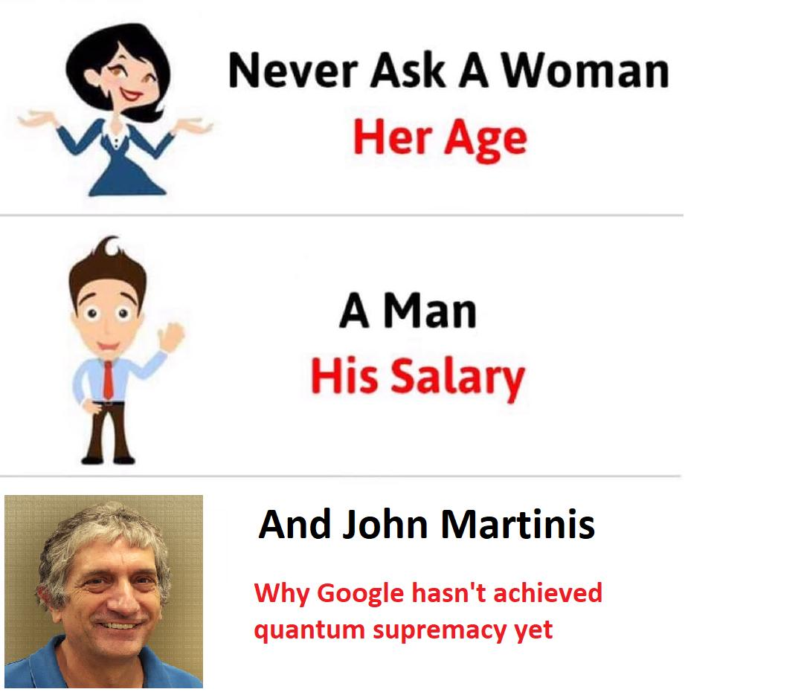
Some QMemes ForTheWin

Slide 3
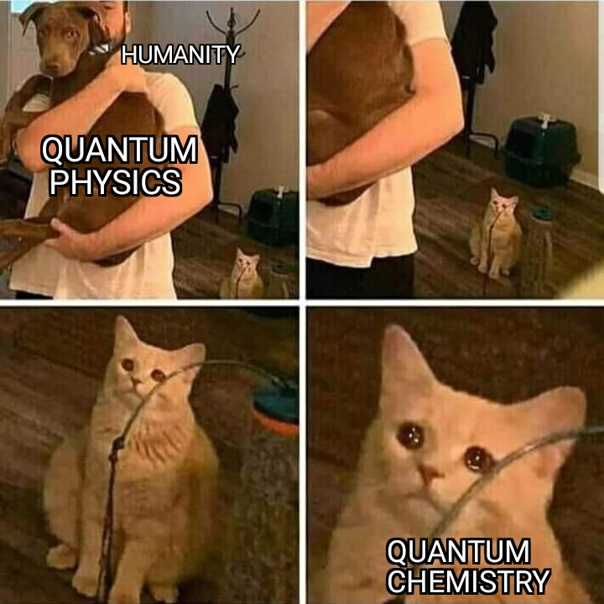
Some QMemes ForTheWin

Slide 4
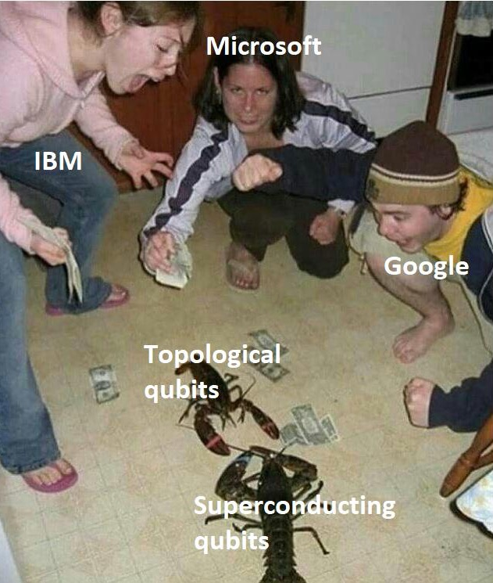
Some QMemes ForTheWin

Slide 5
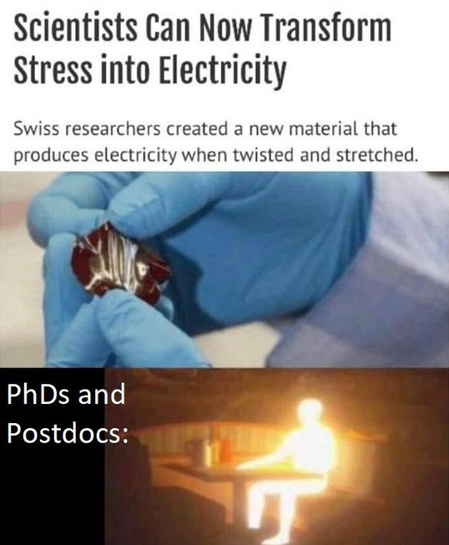
Some QMemes ForTheWin

Slide 6
How to become a QISKIT hero in less than 30 minutes
Journal Club 17/12/2021
Sergio Martínez-Losa Del Rincón

Slide 7
How to become a QISKIT hero in less than 30 minutes
WITH MEMES
Journal Club 17/12/2021
Sergio Martínez-Losa Del Rincón

Slide 8
InRealLife Kuantum FysiKs 🤯
Nobody understands it, Einstein hated it
It has lot of hype in films
People commited suicide while studied it
Plenty of internet memes that nobody understands

Slide 9
InRealLife Kuantum FysiKs 🤯
Nobody understands it. Einstein hated it
It has lot of hype in films
People commited suicide while studied it
Plenty of internet memes that few understands
Seems interesting…
Let’s dive into QISKIT!!!!

Slide 10
What the FACTS on QISKIT
Released on March 2017, Python framework
Terra: Foundational
Aer: Quantum Simulators
Ignis: Noise verifications, error correction
Aqua: Deprecated, now on Finance, ML, Nature
Optimization: Optimization problems
Finance, Machine Learning, Nature: Algoritms and ground state energy computation

Slide 11
What we need to start
Create an account on https://quantum-computing.ibm.com/ and start using Quantum Composer
Install QISKIT on local computer: pip install qiskit
Optional for a better local installation: Anacoda
All together in this link: https://qiskit.org/documentation/stable/0.24/install.html

Slide 12
What we can do with QISKIT
Create and run Quantum Circuits on local Quantum Simulator or remote devices with a number of Qubits, all kind of algorithms used in QC like Grover…

Slide 13
What we can do with QISKIT
Create and run Quantum Circuits on local Quantum Simulator or remote devices with a number of Qubits, all kind of algorithms used in QC like Grover…
The only limit is the imagination

Slide 14
Interactive documentation
Interactive QISKIT playground: https://qiskit.org/textbook
Run Quantum Circuits live while you are studying and reading the documentation

Slide 15
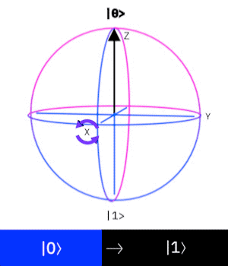
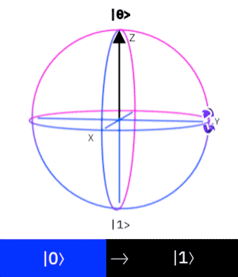
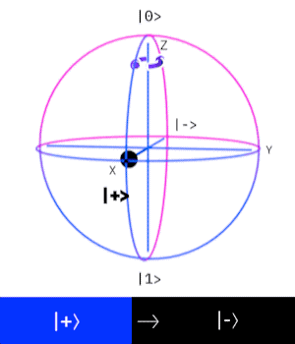
Single QUBIT - Examples
X-gate
Y-gate
Z-gate

Slide 16
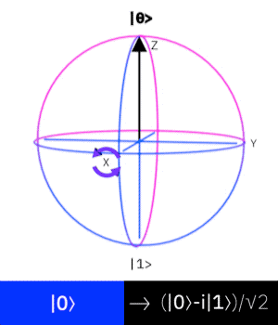
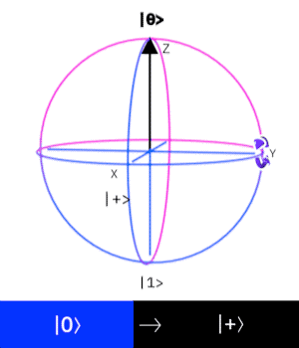
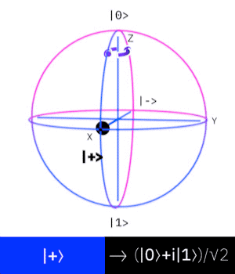
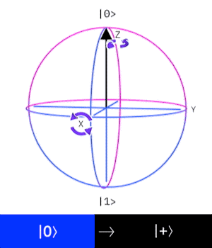
Single QUBIT - Examples
RX-gate
RY-gate
RZ-gate
H-gate

Slide 17
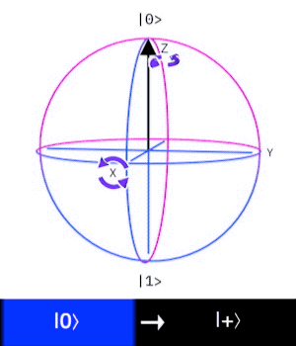
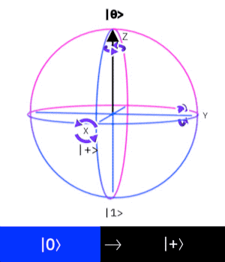
Generic one QUBIT GATES
U1(pi/2)
U2(pi/2, pi/2)
U3(pi/2, pi/2,pi/2)

Slide 18
Two or more QUBIT GATES
CX: Controlled CNOT
CCX: Toffoli (Controller-Controller-CNOT)
CH: Controlled Hadamard
CRZ: Controlled Rz
Each QISKIT revision adds more gates and functions

Slide 19
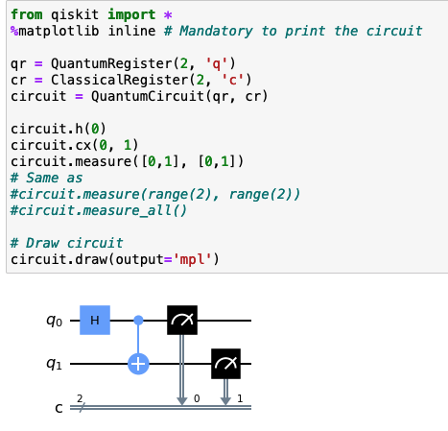
First Quantum Circuit

Slide 20
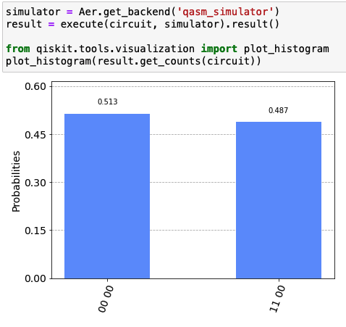
First Quantum Circuit

Slide 21
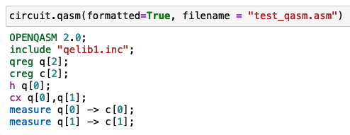
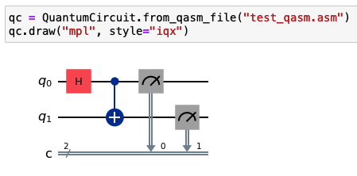
QASM
Assembly Language for QISKIT - “Machine code”
Load QASM file
Convert and save to file QISKIT circuit

Slide 22
Provider & Backend concept
Backend is all software or real device we use to measure the circuit
We must select a provider to obtain its backends
Query the provider to obtain the best backend for our experiment

Slide 23
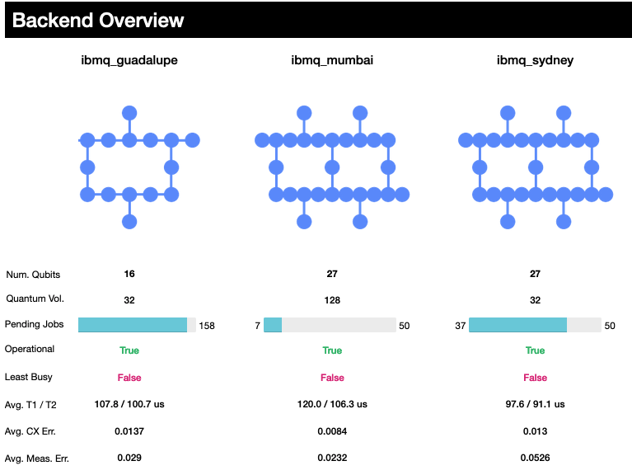
Provider & Backend concept
%qiskit_backend_overview gives the information for all Quantum Devices (backend) from the provider

Slide 24
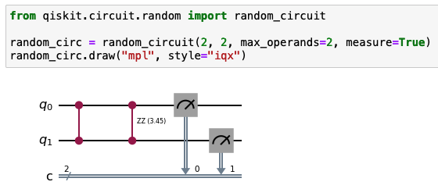
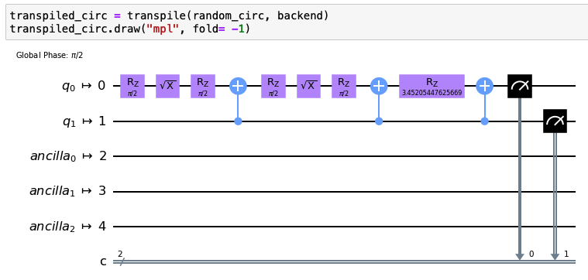
Quantum Circuit transpile
Transpilation means to convert to Quantum Circuit into basis gates that implements the backend

Slide 25
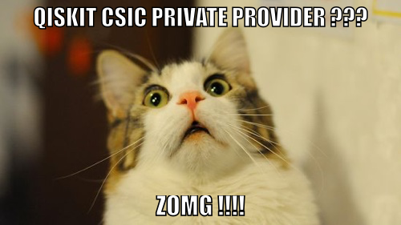
QISKIT private provider

Slide 26
QISKIT private provider
IBM gives to CSIC a private provider with 18 devices up to 65 QUBITS and 5 simulators
Steps to sign up: https://qst.csic.es/ibmq/csic-ibm-questions/
Create an IBM Quantum Experience
Be part of a research group or organization is required as well as a team leader person that creates the petition
Only available for CSIC staff

Slide 27
QISKIT Metal (sneak peak)
Design, modeling, prototype and test Quantum Systems
Superconducting circuits (CPW), Qubits calibration with Qiskit Pulse, Transmon systems
More info: https://qiskit.org/metal/
Installation and tutorials: https://github.com/Qiskit/qiskit-metal

Slide 28
Quantum Fun
Let’s use a Quantum System to draw
Build images to check state preparation of QUBITs
Check the error of certain gate on many Quantum Systems (% of wrong pixels)
Unusual use for a Quantum System
Just for FUN, WHY NOT!!!!!

Slide 29
How to create the QImage
Create an black and white image
Use one-hot encoding to save the image into CSV file as 0’s and 1’s
Split CSV columns in groups of N-QUBITS
Create all Quantum Circuits and store in array
Group circuits in max. number of experiments per backend, launch 1024 shots per circuit

Slide 30
Quantum Drawings
SIMULATOR
SIMULATOR
5-QUBIT BACKEND
5-QUBIT BACKEND

Slide 31
Quantum Portraits Gallery

Slide 32
Quantum Fistro Diodenal
7-QUBITS LATER

Slide 33
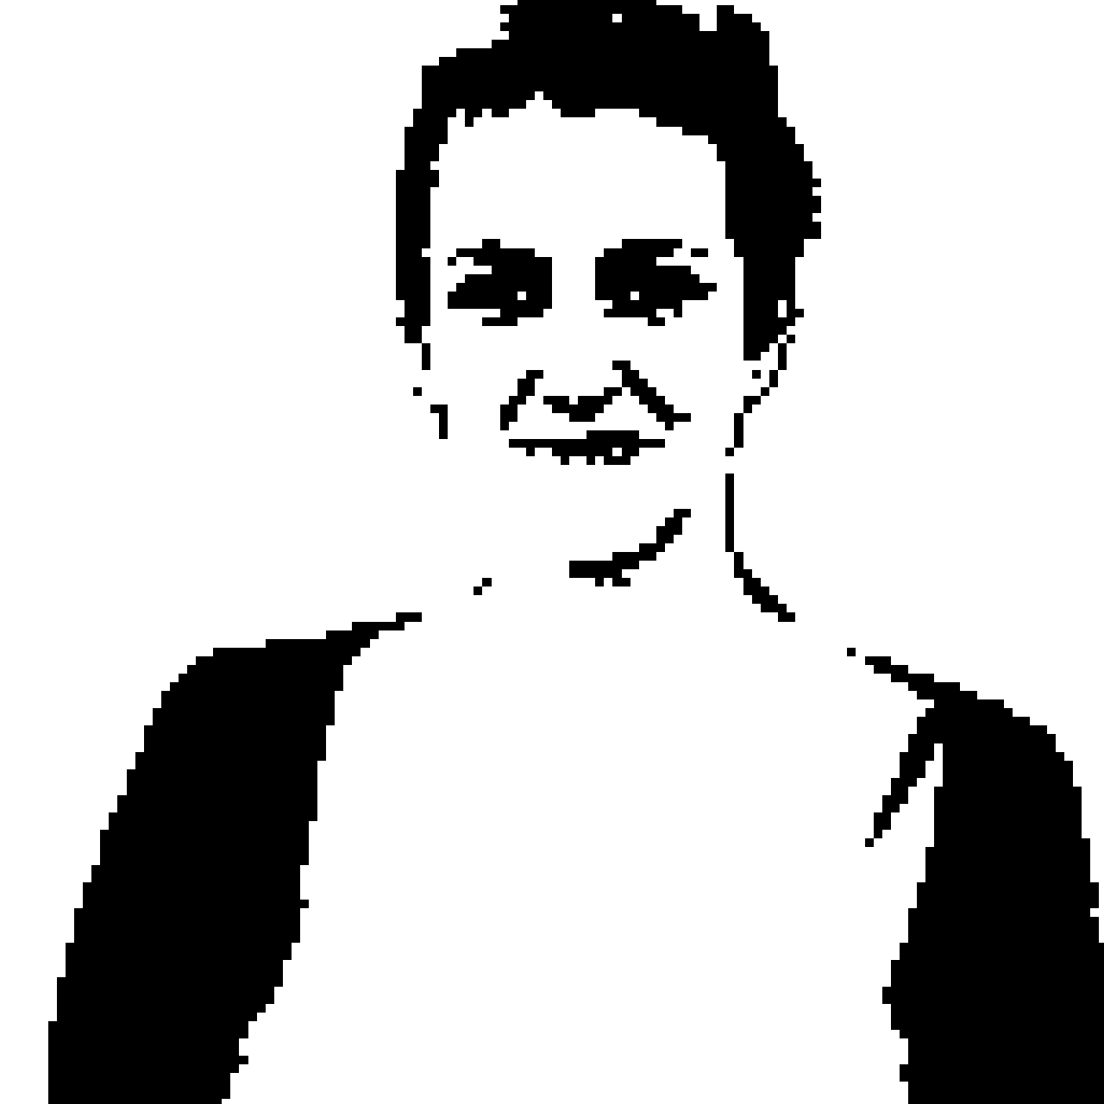
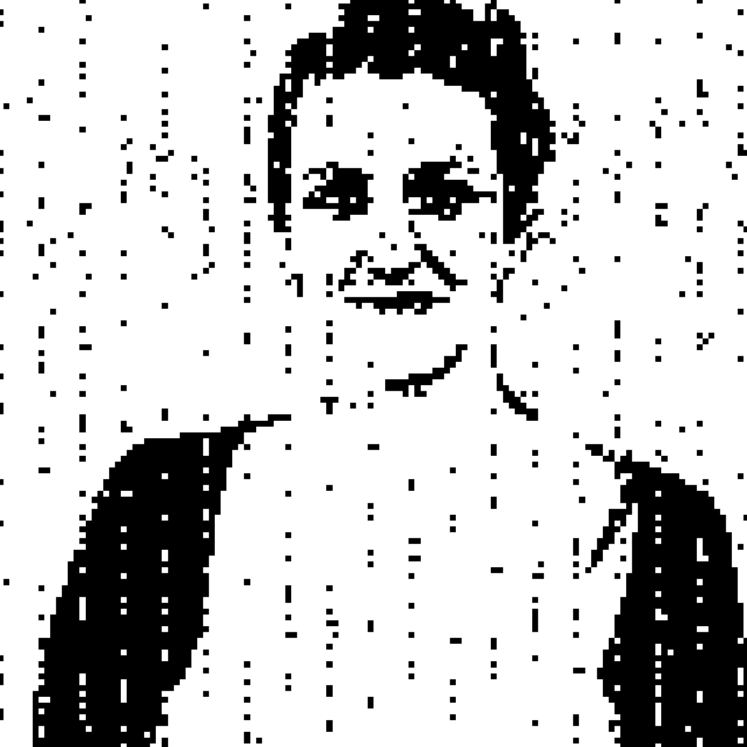
Quantum Pepa
7-QUBITS LATER

Slide 34
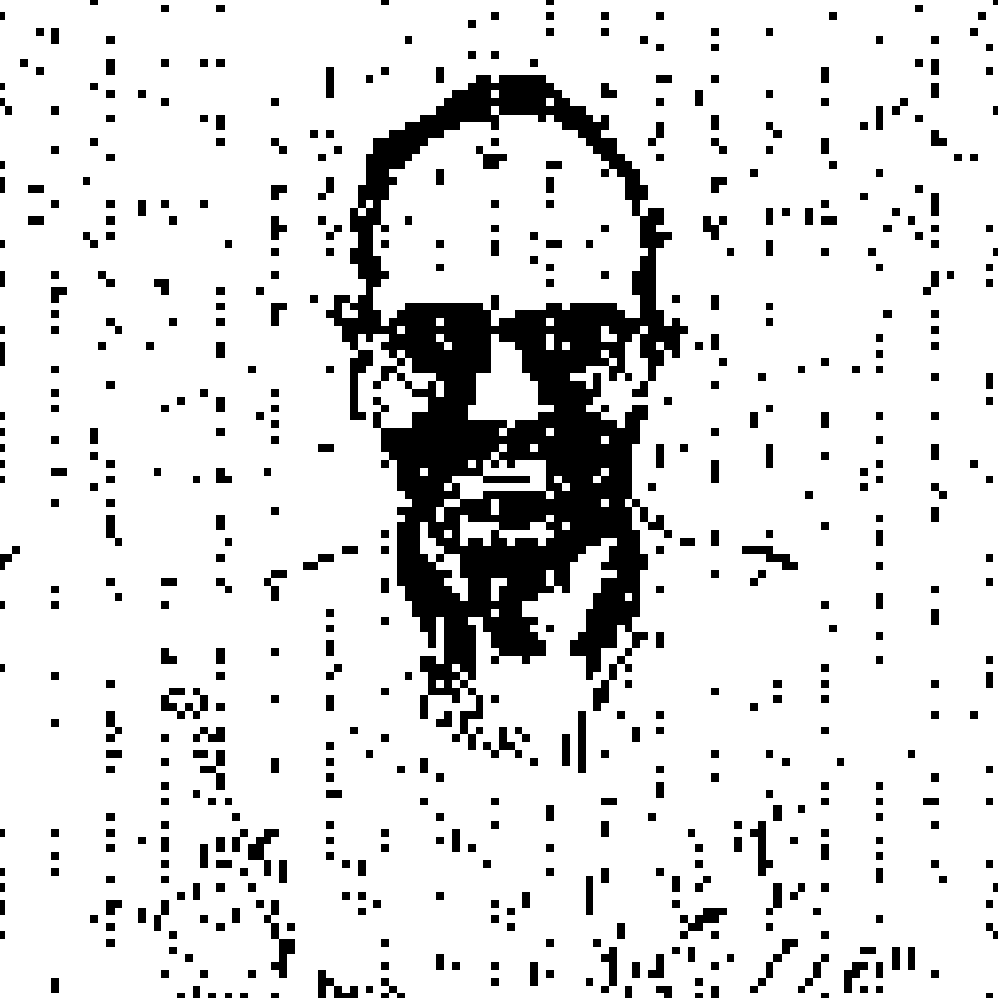
Quantum Fernando
7-QUBITS LATER

Slide 35
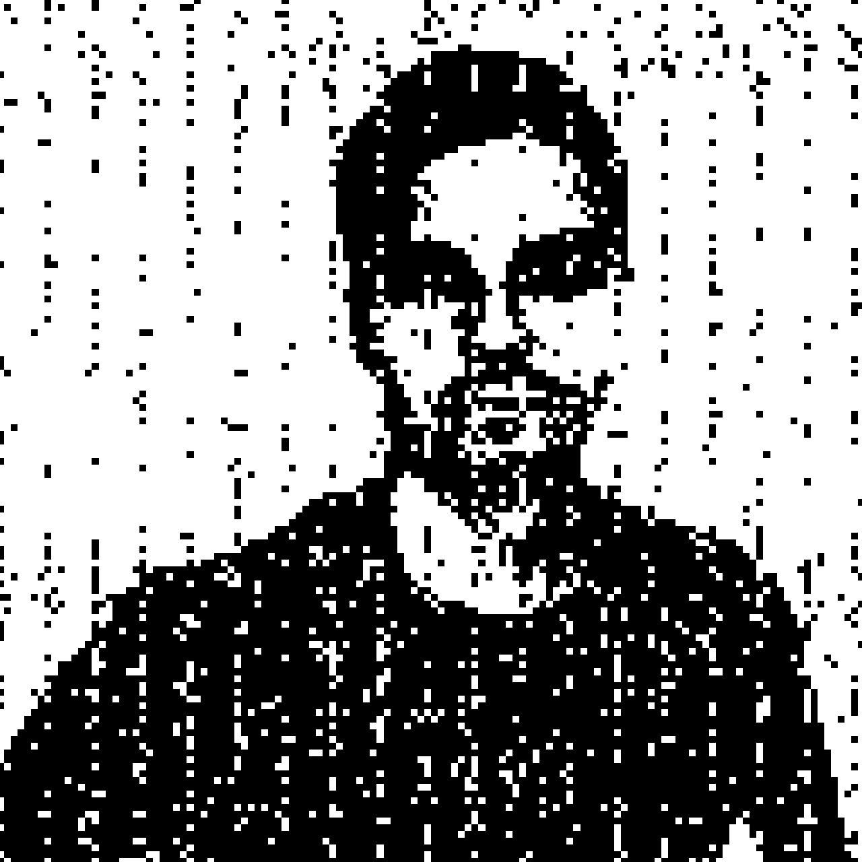
Quantum David
7-QUBITS LATER

Slide 36
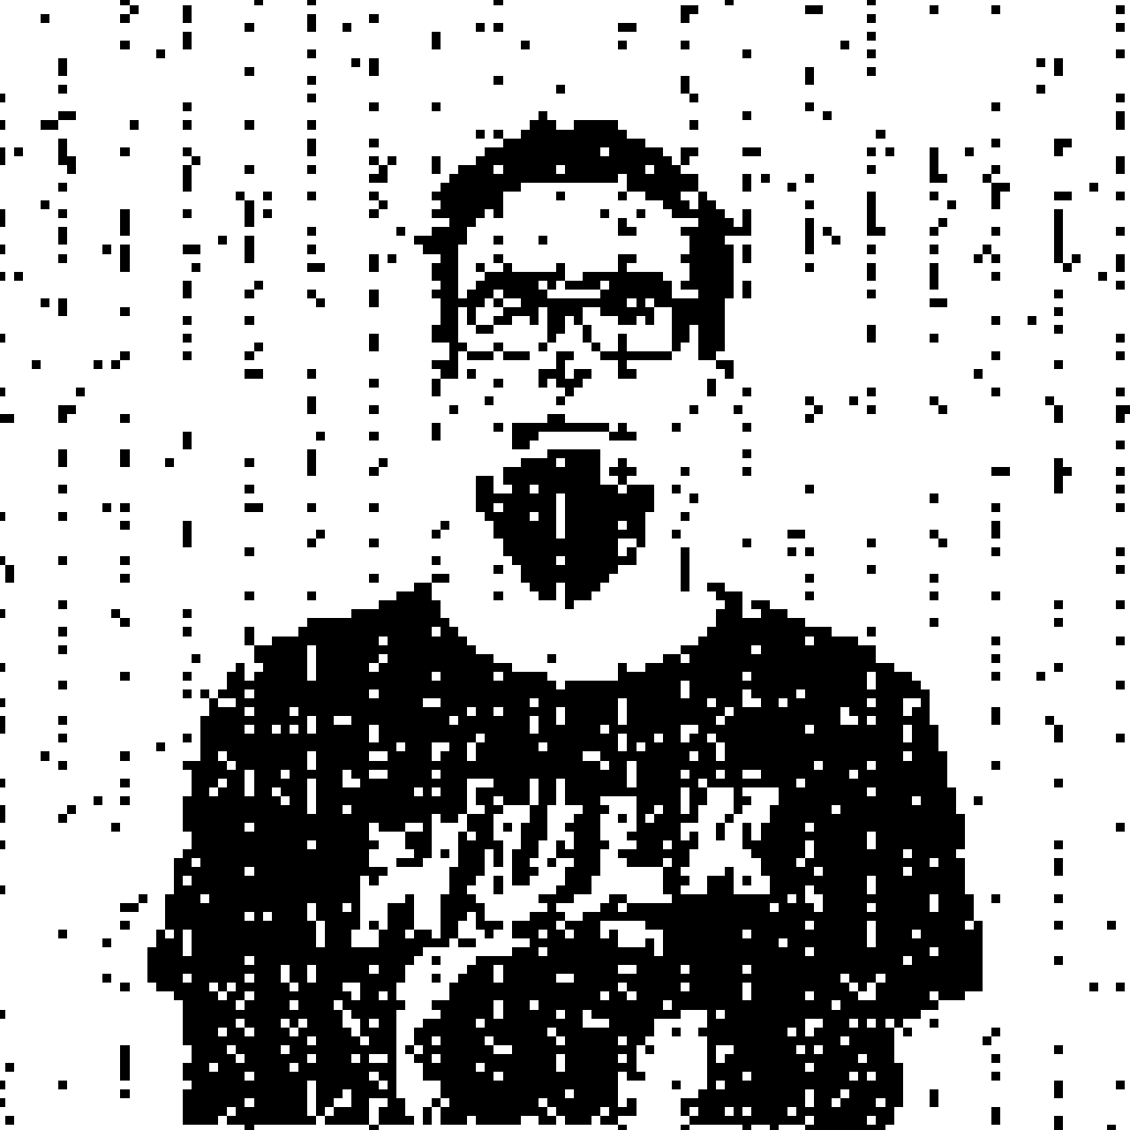
Quantum Carlos
7-QUBITS LATER

Slide 37
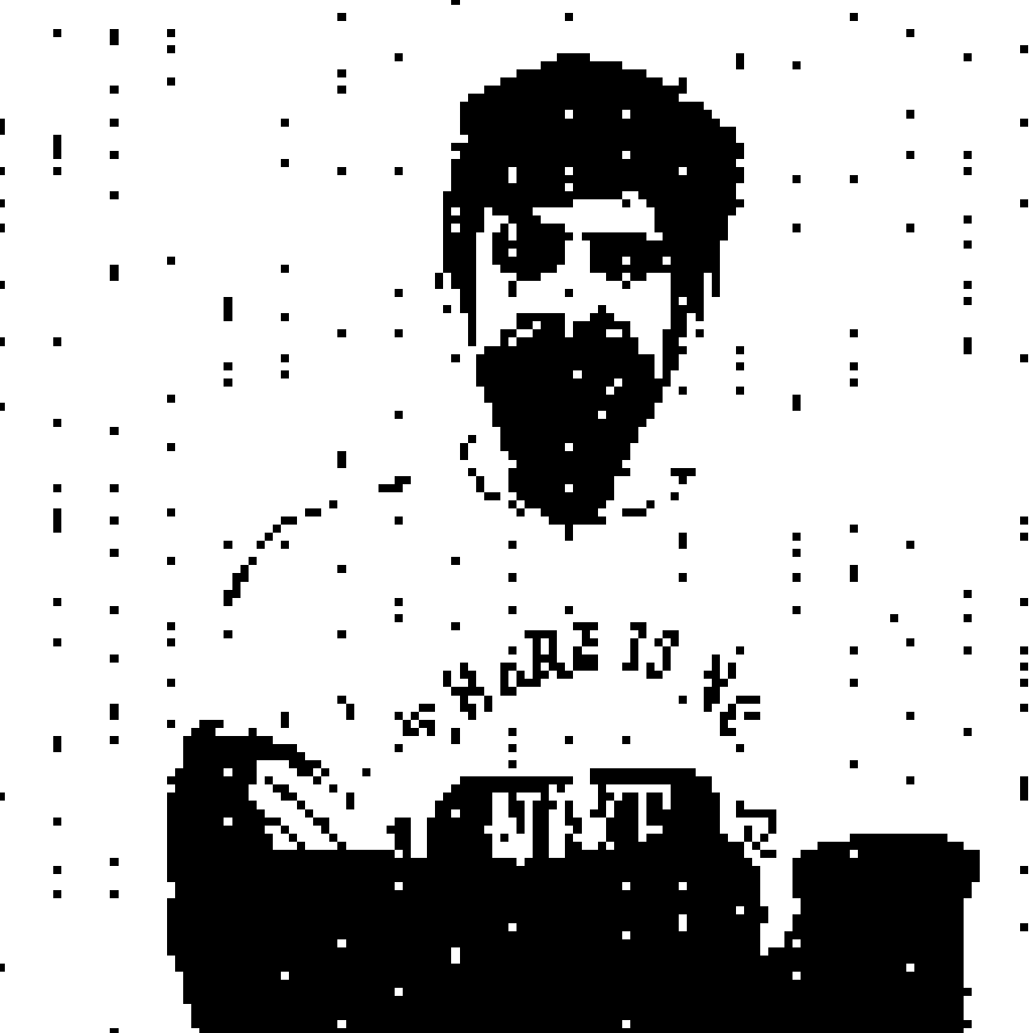
Quantum Victor
7-QUBITS LATER

Slide 38
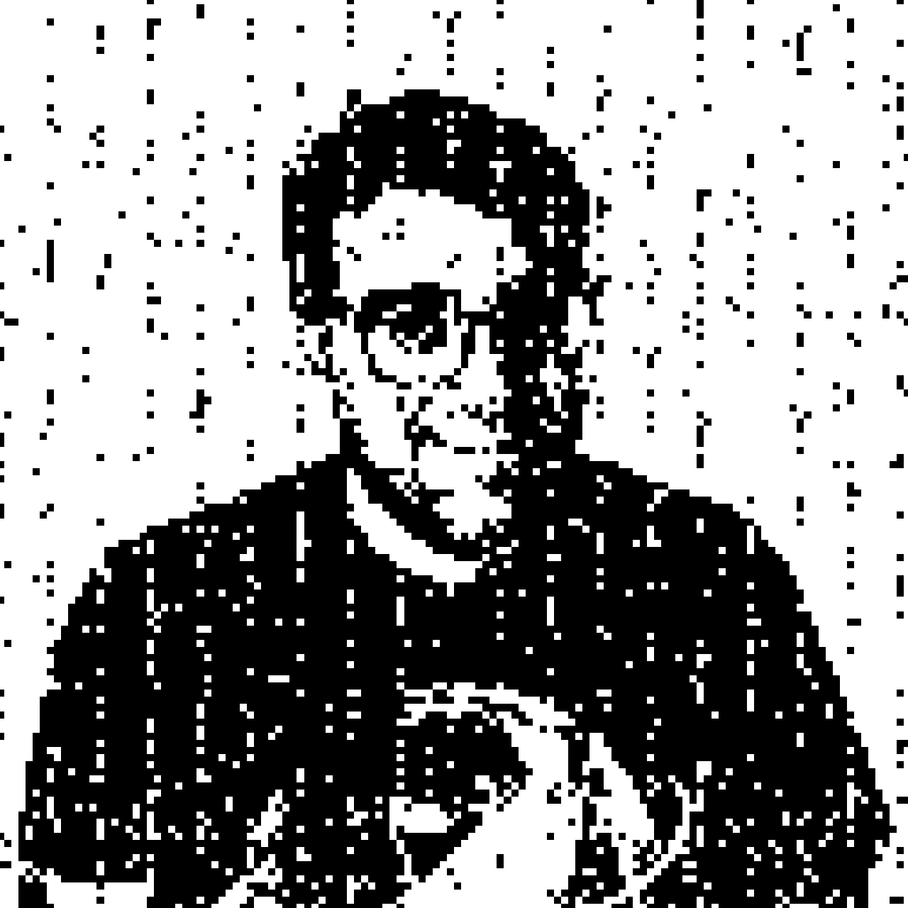
Quantum Me
7-QUBITS LATER

Slide 39
Hackatons & Summer School
Exclusive feedback and meetings with topmost people on Quantum Computing, QML, QFinance and many more
There are 3 or 4 meetings along the years
Some of them are huge prizes as many universities are involved
There are participation badges and vouchers giveaway for IBM certifications (just for participating like Hackaton October 2021)
Everybody is purchasing a QISKIT t-shirt, and everybody ask for it in ALL HACKATONS….NO ANSWER FROM IBM

Slide 40
QISKIT Certification
First certification of Quantum Computation
An IBM QISKIT Developer is an individual who demonstrates fundamental knowledge of quantum computing concepts (pass 44/60 questions, 90’)
It is a good chance to be recognised by IBM
A good starting point to be a IBM employee
https://www.ibm.com/training/certification/C0010300

Slide 41
QISKIT Certification
FREE VOUCHER GIVEAWAY RIGHT NOW
https://airtable.com/shrEZlRker8zUukUf

Slide 42
QISKIT Slack channels
1 to 1 interactions with all the QISKIT community and inside IBM
Official channel to disclose all new features and new related with QISKIT and papers from other people
IBM staff usually ask for feedback fromo users with reviews, surveys or personal interviews
All Slack channels are free to join

Slide 43
Community translations
QISKIT Textbook needs translators, you can join free and obtain some “special points” whenever you need some help or you want to apply to Advocate Program (https://github.com/qiskit-community/qiskit-translations)
Spanish language is almost done, almost nothing to do here, but always things to correct
All other languages are still in progress, why not have a lot at that?

Slide 44
QISKIT Advocate program
This is almost like an “internship” at IBM
You are granted to latest systems and IBM will require you for hackatons support
People that get involved heavily maybe end up at IBM as staff, depending the background academia
Once a year you can apply. Sending all your achievents in hackatons, translations, QISKIT courses, certifications and everything you think is important

Slide 45
Other QCompanies
Notes:
D-WAVE: Quantum Computers based on Quantum Annealing (optimization problems)
Rigetti: Quantum Computers and the superconducting quantum processors
XANADU: Quantum Computers with photonic technology
Strawberry fields: A cross-platform Python library for simulating and executing programs on quantum photonic hardware.
Pennylane: A cross-platform Python library for differentiable programming of quantum computers. Train a quantum computer the same way as a neural network.

Slide 46
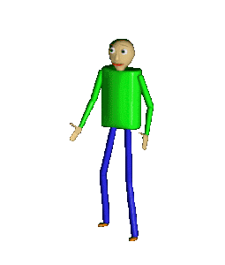
Thank you!
Now it’s questions time!
EMAIL: sergiomtz.losa@unizar.es
GITHUB: https://github.com/sergiomtzlosa
My desk is at department 1203, I can hold a conversation with everybody
When you have real life problems, but remember that everything reduces to a simple harmonic oscillator (wise meme)

